Slide 1

Mathematics in Machine learning Tesina Wine Quality Dataset
Tommaso Massaglia S292988
A.A 2021/2022

Slide 2
Introduction

Slide 3

Introduction – Wine Quality Dataset
To support the growth of the wine industry from luxury to generalized good, the producers began collecting several physiochemical descriptors to aid in the production phase.
One of the most important parameters when determining certifications is the quality of the wine itself, which is usually determined by an expert’s evaluation.
The dataset was first collected in 2009 for a study whose goal was to create a tool able to evaluate a wine quality during production, without human intervention.
wine quality dataset - tesina

Slide 4
Data Exploration

Slide 5
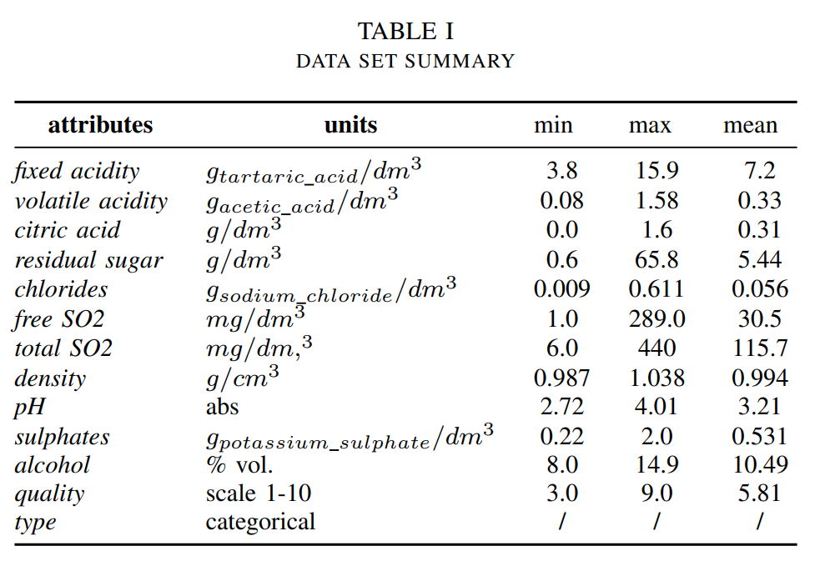
Data Exploration – General Overview
The dataset is provided as two separate sheet, one for white wine and one for red.
For the purpose of the tesina, the two data sets were merged to carry out a binary classification as well.
Each value of the dataset has 13 distinct attributes that, excluding the target ones which are quality and type, measure one of the physiochemical descriptors a wine can have.
There are a total of 1599 red wine, 4898 white wines and no missing data.
wine quality dataset - tesina

Slide 6
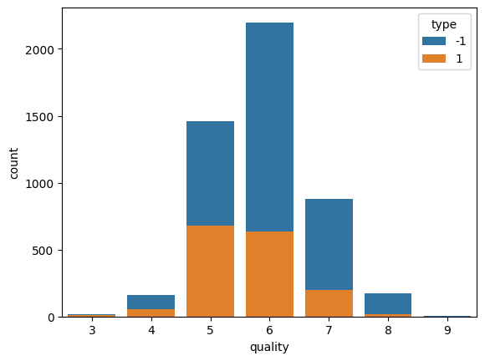
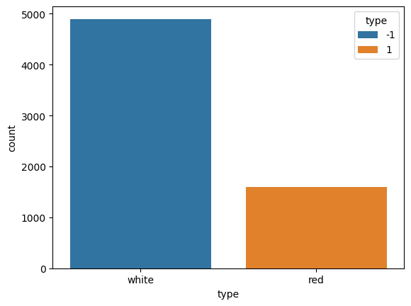
Data Exploration – General Overview
The quality is mostly normally distributed, with no values going under three and over 9
Looking at the type, we can see the data is unbalanced towards the white type
wine quality dataset - tesina

Slide 7
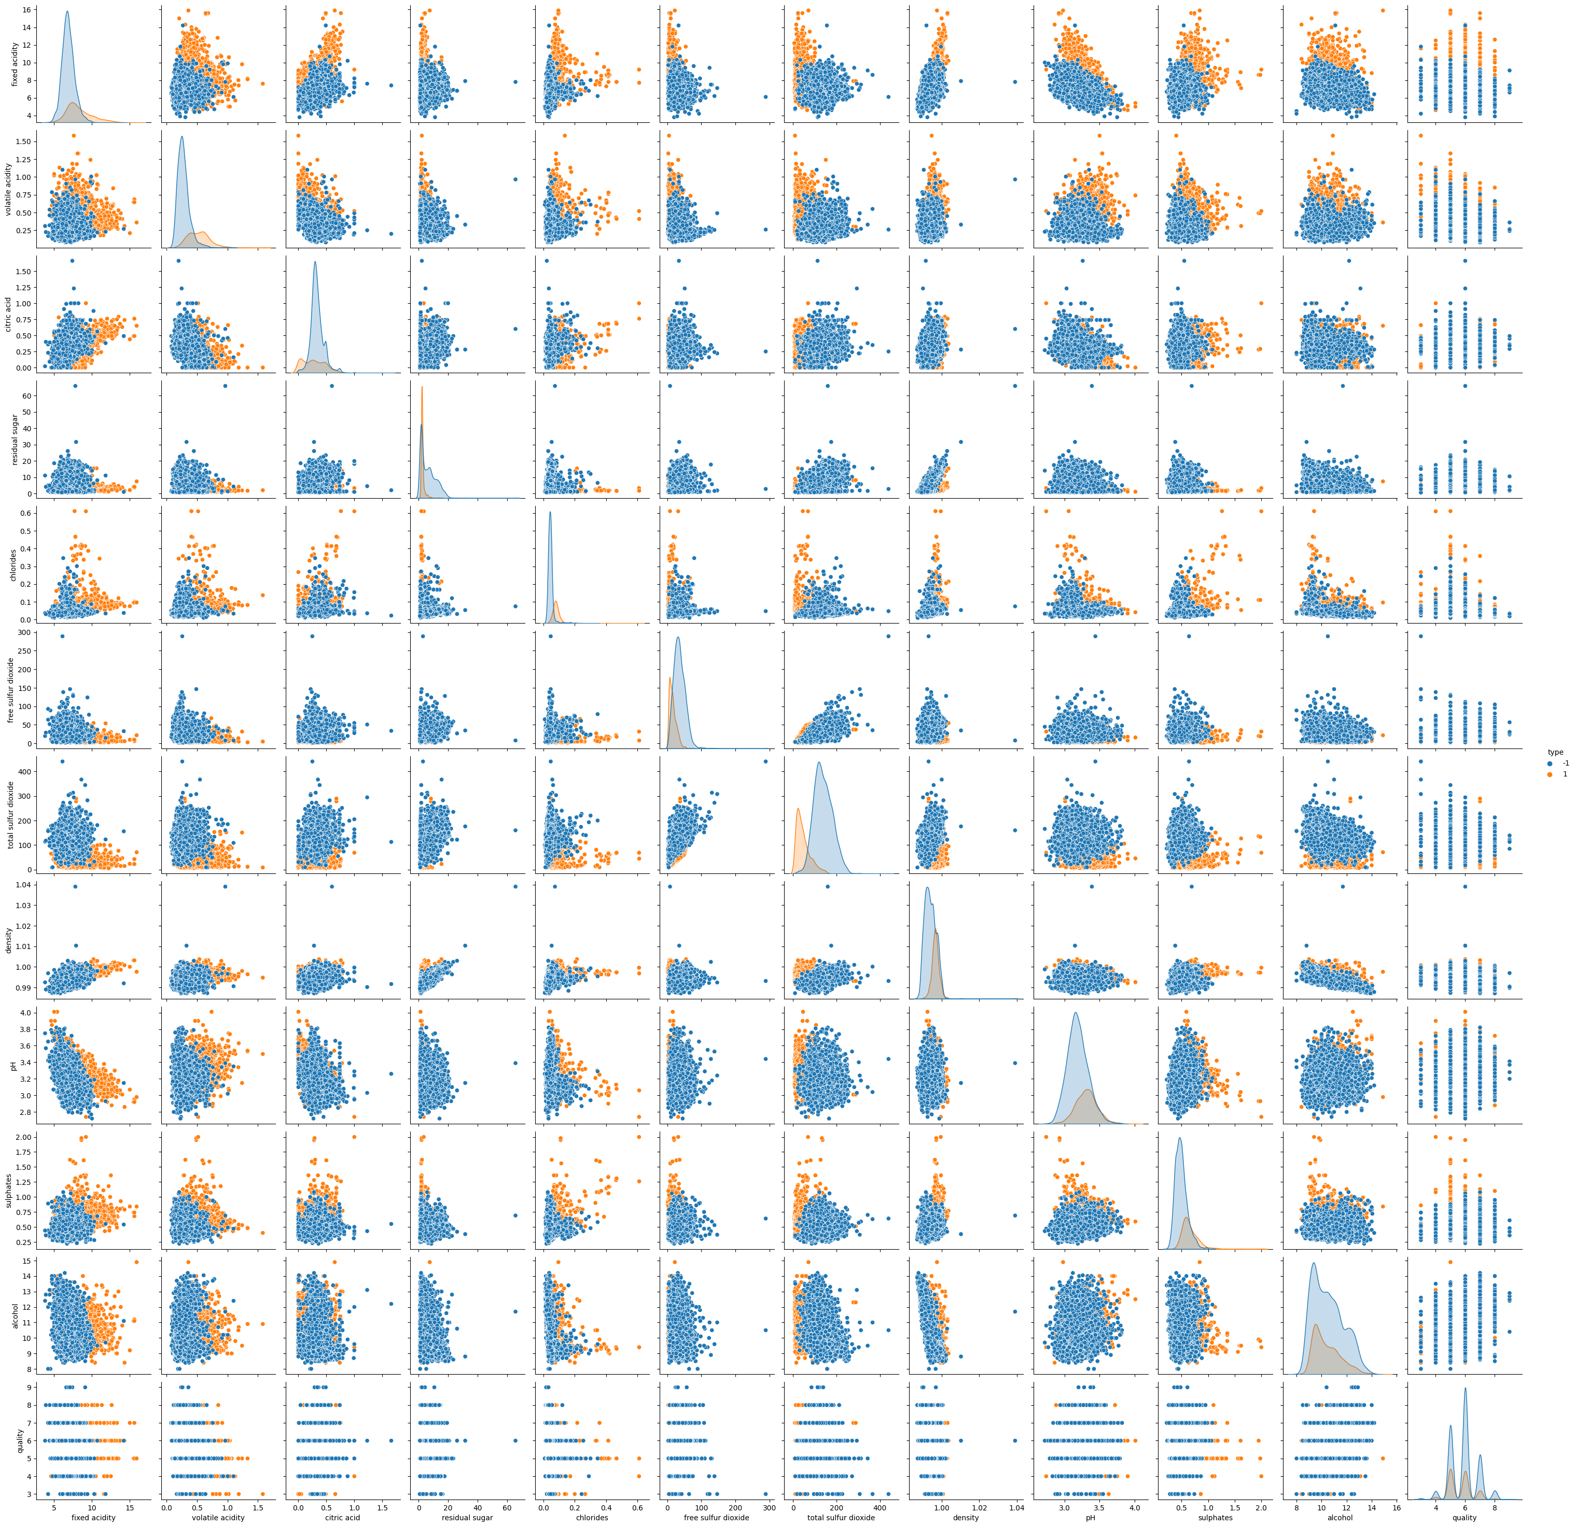
Data Exploration – Correlation
The seaborn pair-plot show the pairwise relationships between the available attributes for each cell excluding the diagonal ones, which are univariate distribution plots.
From a general overview, we cannot see any meaningful shape in the pairwise plots.
The univariate distribution plots show that the data is mostly normally distributed, we can assume a normal distribution for each value.
wine quality dataset - tesina

Slide 8
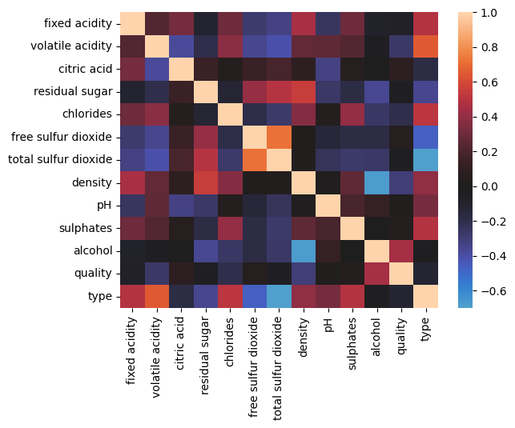
Data Exploration – Correlation Heatmap
A heat map built on a correlation matrix allows to show in a graphically intuitive way the correlation between attributes.
From the heatmap we can see
Type is strongly correlated with volatile and fixed acidity, total and free SO2, and residual sugar
Quality has no strong correlations but is influenced by alcohol and density the most
Type and Quality (target attributes) have little to no correlation.
wine quality dataset - tesina

Slide 9
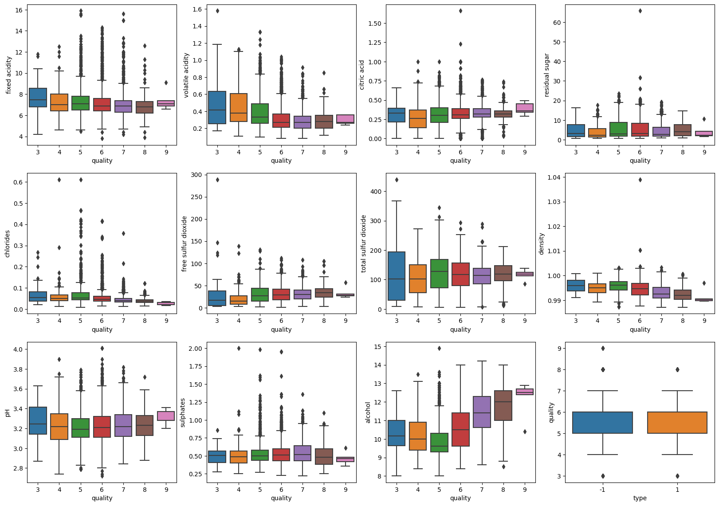
Data Exploration – Boxplots, quality
wine quality dataset - tesina

Slide 10
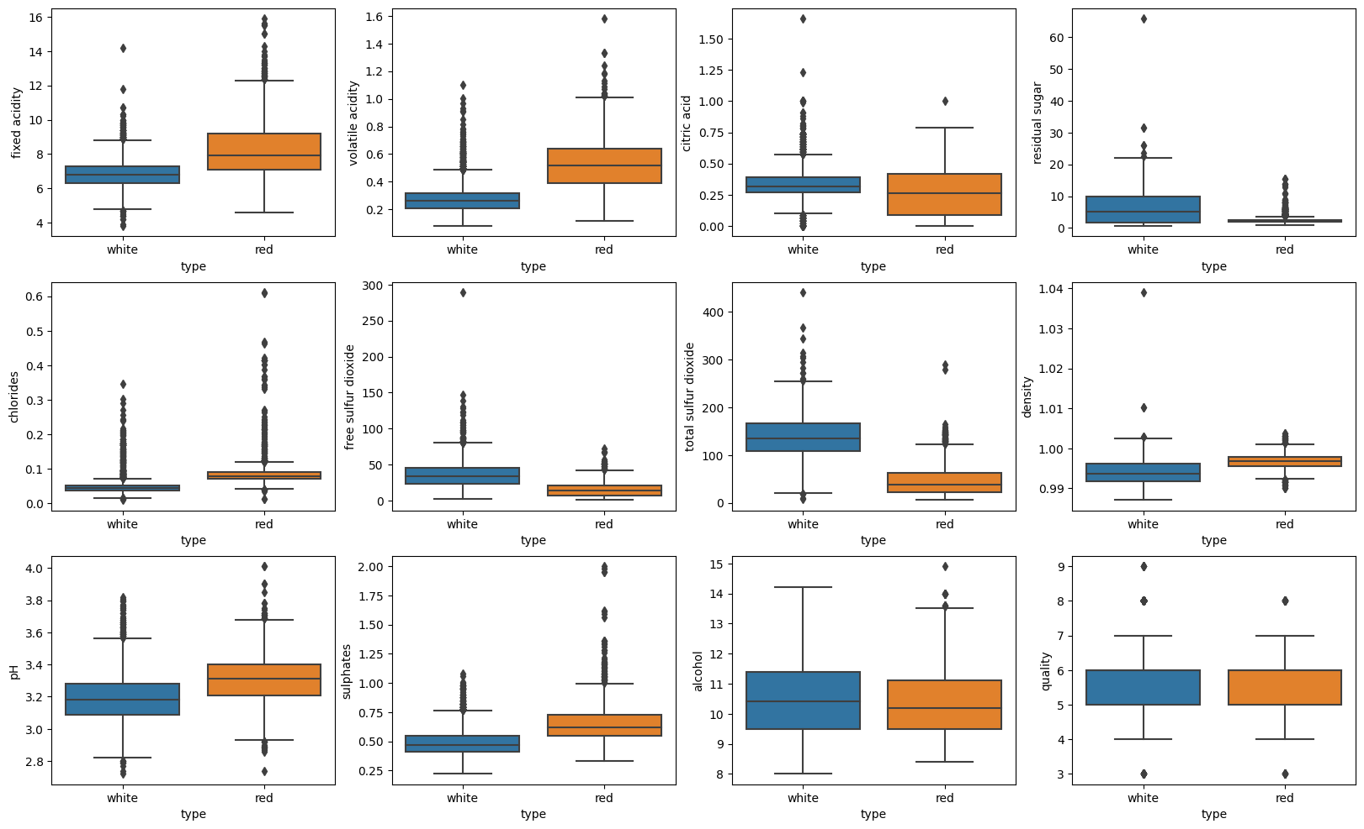
Data Exploration – Boxplots, type
wine quality dataset - tesina

Slide 11
Preprocessing

Slide 12
Pre-processing – Introduction
Data pre-processing is an important step in machine learning and data mining.
The data found in large dataset can be often in a form that is detrimental to the goal of training an ML model.
Large variance, excess of attributes and outliers are a only few of the many unwanted characteristics we tend to find in our data.
Pre-processing or Data Preparation is the preliminary step to training in which we clean and improve our data for the subsequent steps.
CLEANING
TRANSFORMATION
REDUCTION
wine quality dataset - tesina

Slide 13
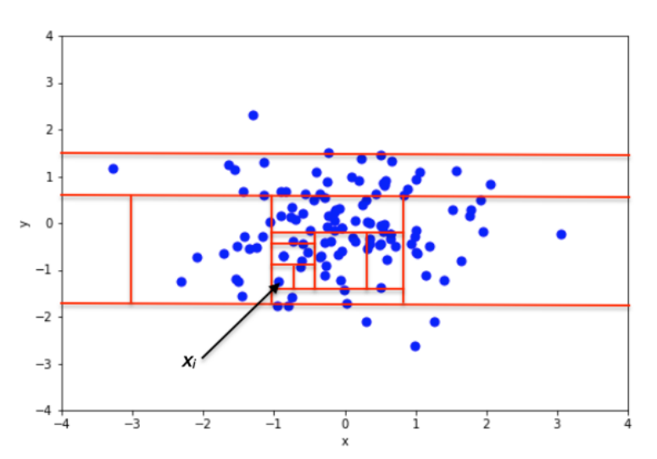
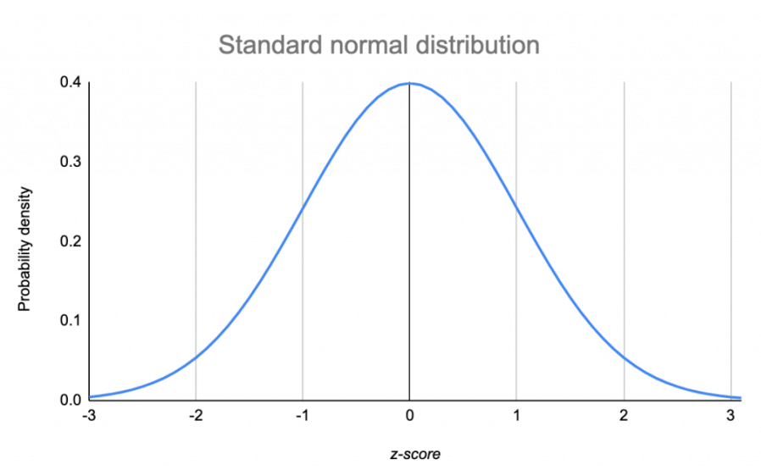
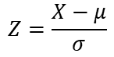
Pre-processing – Outlier Detection
Z-Score
Isolation Forest
The z-score of an observation can quantify its unusualness when our data follows the normal distribution. The further away Z is, the more unusual the data point is.
The Isolation Forest algorithm is an ensemble outlier detection method. It works by recursively and randomly creating partitions, which can be represented by an isolation tree, and by marking outliers as the ones that require fewer partitions to be isolated.
$$Z=\frac{X−μ}{σ}$$
wine quality dataset - tesina

Slide 14
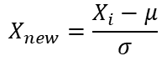
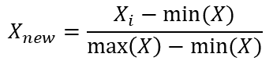
Pre-processing – Feature Scaling
Machine learning models profit greatly by having the values they are fed scaled; the advantage of training a model with scaled data is that the resulting model doesn’t give more weight to larger values than it does to other, and vice versa for smaller values.
Min-Max normalization
Standardization
The values of a feature are scaled to have distribution between 0 and 1
The values are rescaled to have a distribution with mean 0 and variance 1
$$X_{new}=\frac{X_{i}−min⁡(X)}{\max\left(X\right)−min⁡(X)}$$
$$X_{new}=\frac{X_{i}−μ}{σ}$$
wine quality dataset - tesina

Slide 15
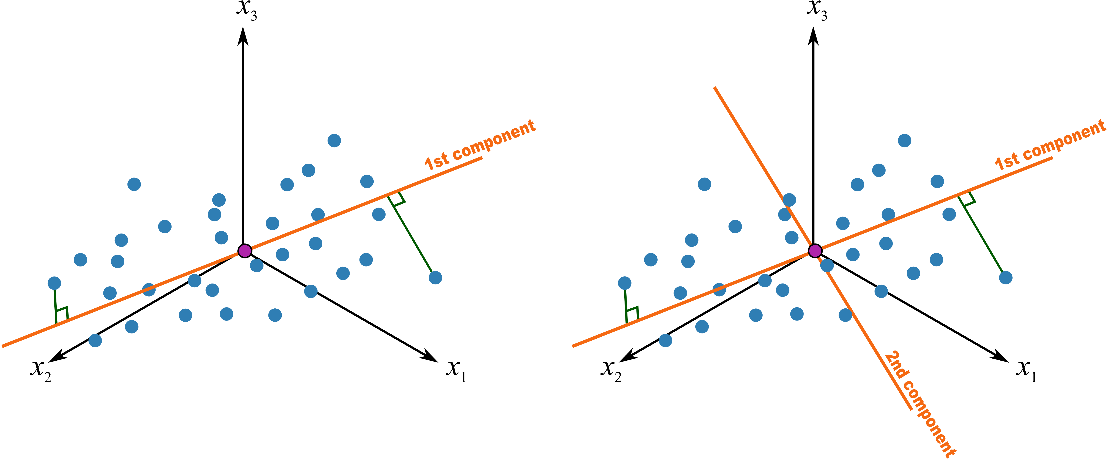
Pre-processing – Principal Component Analysis (PCA)
Principal Component Analysis, in short PCA, is the process of computing the principal components and using them to perform a change of basis on the data, usually using the first few principal components and ignoring the rest.
The main advantage of using PCA lies in the ability to reduce the dimensionality of the data set while preserving as much variability as possible.
The principal components that are computed in PCA are the sequence of p unit vectors where the i−Th vector is the direction of a line that best fits the data while being orthogonal to the first i − 1 vectors.
wine quality dataset - tesina

Slide 16
Pre-processing – Outlier Detection
Whenever we train a ML model with an unbalanced dataset, we risk making the prediction more favorable for the label that appears the most. Re-Sampling allows us to balance back the dataset.
SMOTE
Random Undersampling
Synthetic Minority Over Sampling works by generating synthetic data points which are close to the original data.
Under-sampling does not require as much work as oversampling does; one common approach is to randomly choose sample to remove from the majority classes until a more balanced data-set is obtained.
SMOTE:
Select a minority class instance at random
Find the instance K nearest neighbours
Chose one of the k nearest neighbours
Connect the two points in the feature space
Generate a synthetic instance as a convex combination of the chosen instances
wine quality dataset - tesina

Slide 17
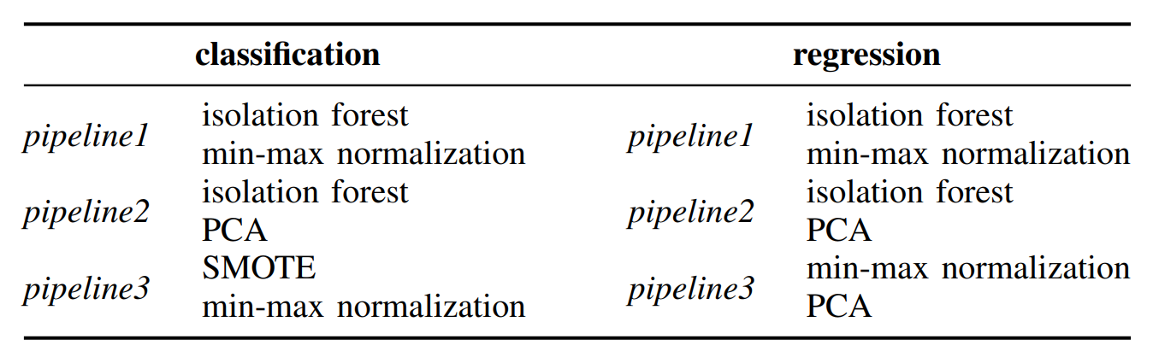
Pre-processing – Pipelines
Sometimes applying more than one technique can lead to beneficial results, the following are the pipelines that were applied in the tesina.
wine quality dataset - tesina

Slide 18
Model Training

Slide 19
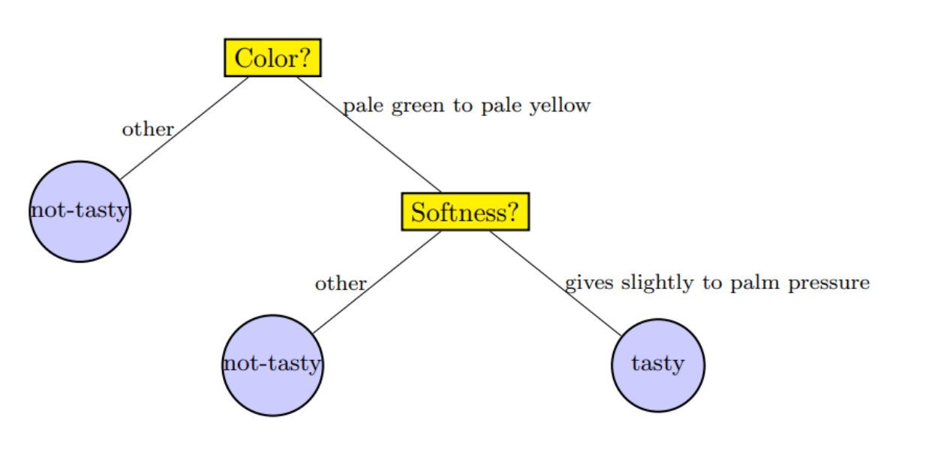
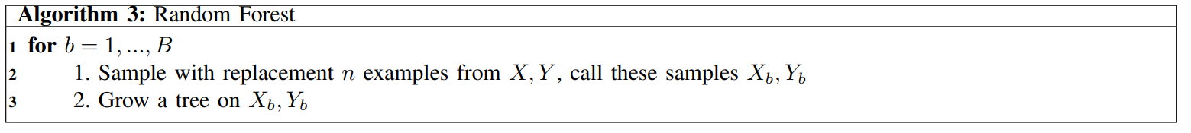
Model Training – Random Forest Classifier
Random Forests are a class of ensemble models that operate by constructing a multitude of decision trees at training time.
Compared to a standard decision tree, random forests reduce the risk of overfitting training data.
Random forests are a kind of bagging algorithm in which we grow several decision trees on random sample of data or on a random choice of attributes and take the most chosen class as the predicted one.
wine quality dataset - tesina

Slide 20
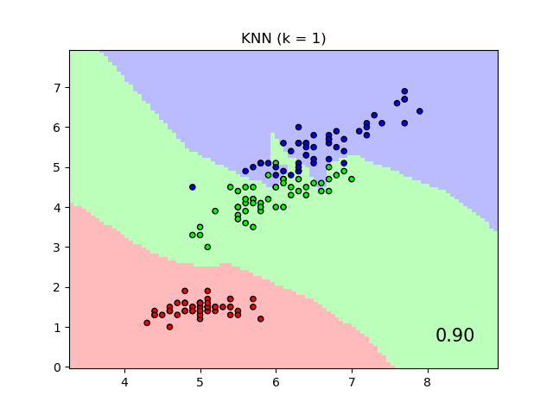
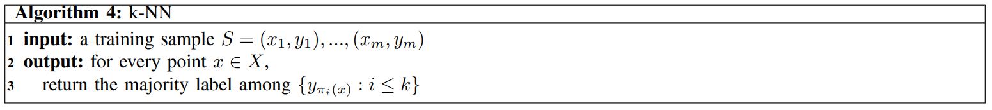
Model Training – K Nearest Neighbours
The K Nearest Neighbour algorithm is a non-parametric supervised learning method that can be used for both classification and regression.
The algorithm for classification works by assigning a new object a label based on what label the k nearest neighbour have.
Its main downsides are its size, as it has to keep in memory all the training data, and its susceptibility to the curse of dimensionality.
wine quality dataset - tesina

Slide 21
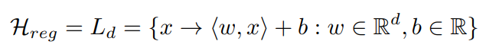
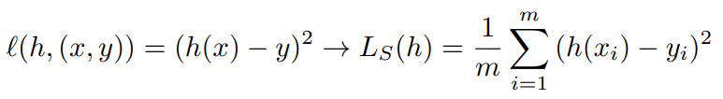
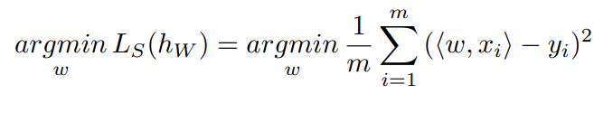
Model Training – Linear Regression
Linear Regression is a common statistical tool used to model the relationship between a scalar response and one or more explanatory variables, since in our case we have a multitude of explanatory variables, the regression is specifically a multiple linear regression.
A linear prediction function, used to model the relationship between input and target.
The squared loss is used to estimate how far the prediction parameters are from the truth.
Least Squares, the algorithm used to find the optimal parameters.
wine quality dataset - tesina

Slide 22
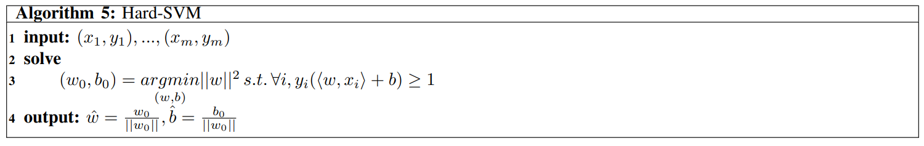
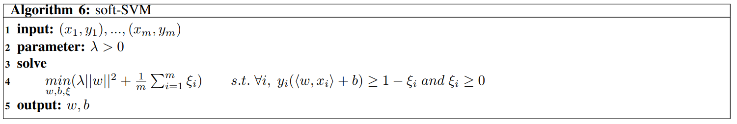
Model Training – Support Vector Machines
The goal of an SVM is to pick the best half space, which is the one that maximizes the margin with respect to the existing data points; this is usually referred to as a hard-SVM.
By introducing some slack variables that allow us to ‘ignore’ the constraint we are solving with we obtain what’s called a soft-SVM
wine quality dataset - tesina

Slide 23
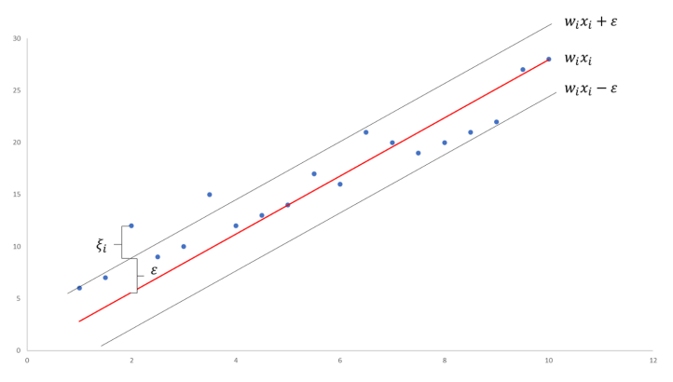
Model Training – Support Vector Machine Regression
Support vector machines were first introduced as a mean to solve a classification task, but algorithms such as epsilon support vector machines allow us to perform regression using SVMs as well, with the advantage of generating a model that is much closer to reality.
wine quality dataset - tesina

Slide 24
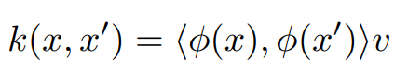
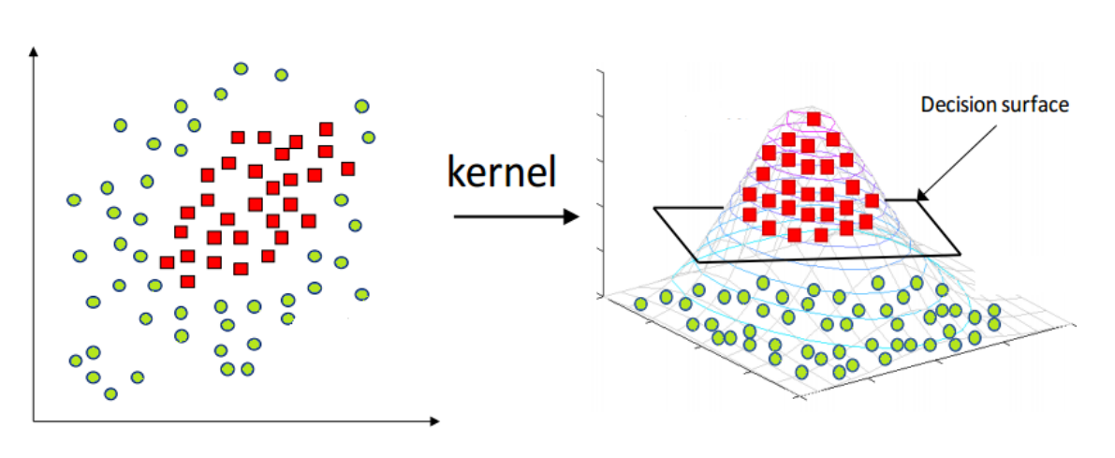
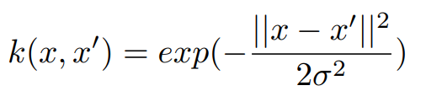
Model Training – Kernel Trick
The Kernel Trick is an important tool available when training a support vector machine: sometimes, data can be more easily separable if ’seen’ from a higher dimension then the one we found it in.
By deciding a kernel function to apply to our data points and by applying it to our data points we manage to operate in a higher dimensional space without having to compute the coordinates in the new space, making the complexity go O(n) rather than O(n^2).
wine quality dataset - tesina

Slide 25
Results

Slide 26
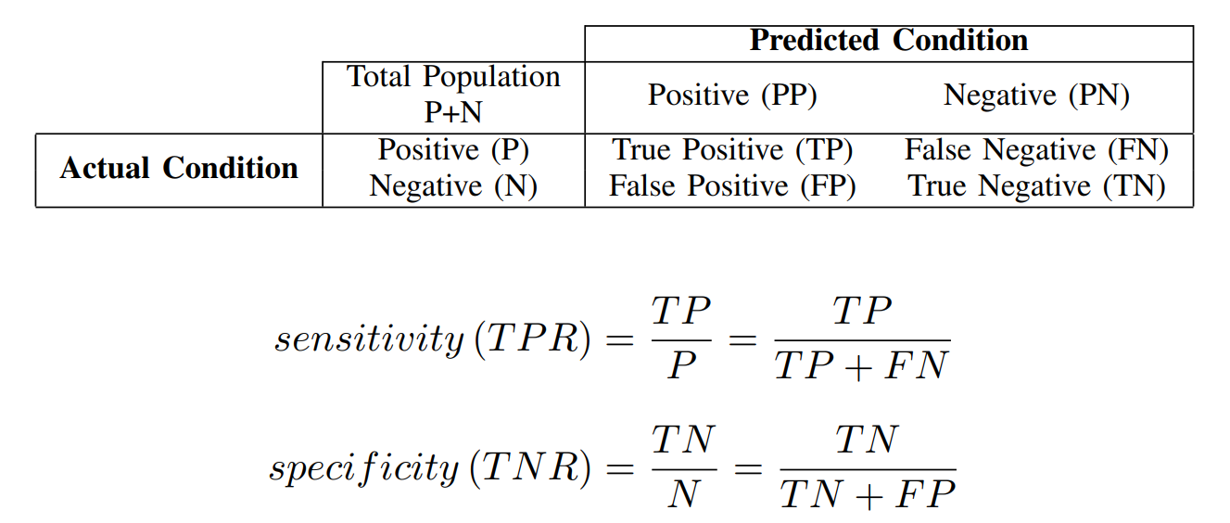
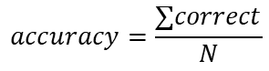
Results – Classification Metrics
The confusion matrix of a set of predictions is a special type of contingency matrix with two dimensions and identical set of classes in both dimensions.
Sensitivity is the rate of correct positives among all positives
Specificity is the rate of correct negatives among all negatives.
The accuracy of a model is a computed as the number of correct classifications given the training set size
$$accuracy=\frac{∑correct}{N}$$
wine quality dataset - tesina

Slide 27
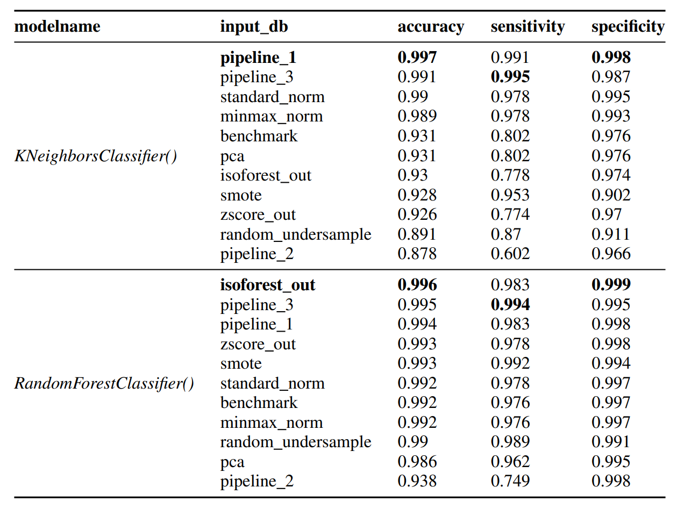
Results – Classification
wine quality dataset - tesina

Slide 28
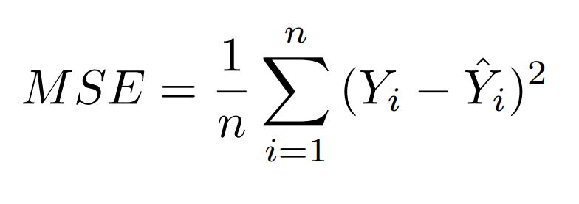
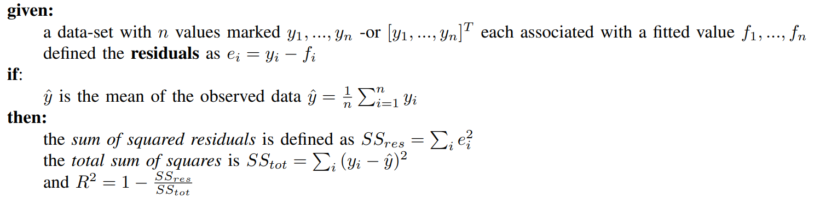
Results – Regression Metrics
The Mean Squared Error measure the average of the squares of the errors and is one of the most used metrics, as it is an estimator of the true average loss on the actual population distribution.
The lower the average error, the lower the MSE.
Also called the coefficient of determination, R-squared is a statistical measure that represents the goodness of fit of a regression model. The closer the value of r-square to 1, the better is the model fitted.
R2 is a comparison between the residual sum of squares with the total sum of squares.
wine quality dataset - tesina

Slide 29
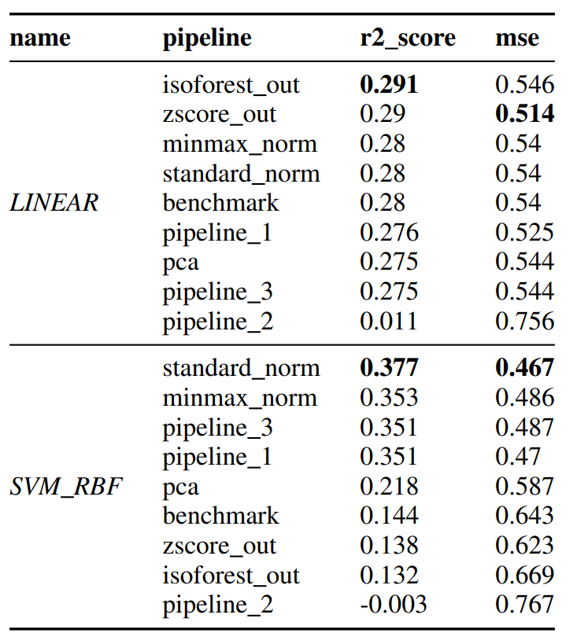
Results – Regression
wine quality dataset - tesina

Slide 30
Thank you for your attention!

Slide 31
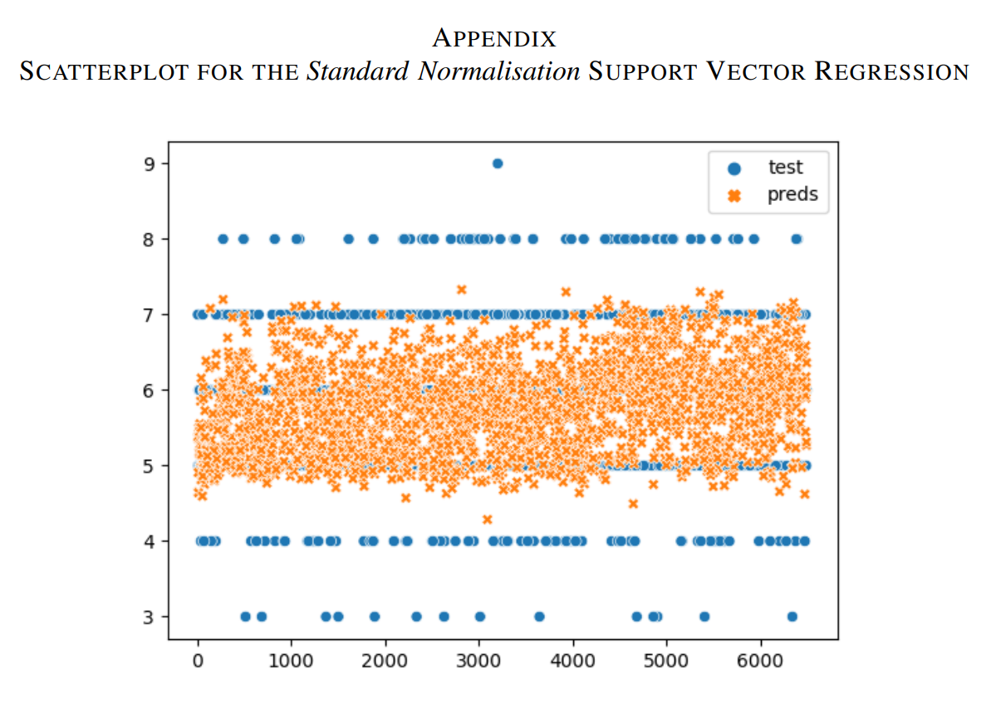
Appendix
wine quality dataset - tesina

